Slide 1
Chapter 2
Mixed operations of addition and subtraction

Slide 2
Book p.4
Operations 運算 | Symbol 符號 | Result 結果
add/plus 加 | + | sum /total 和
minus 減去 | — | difference 差

Slide 3
Book p.4
Mathematical Terms
take away | 取走 | altogether | 共有
left | 還有 | equal | 等於
cross out | 劃去 | question | 問題
more than | 較多 | answer | 結果
fewer than | 較少 | total | 總數

Slide 4
Book p.4
Practice 1
Example: 3 + 2 – 1 = 4
3 plus 2 minus 1 equals 4

Slide 5
Book p.4
Change the followings in to word forms.
1. 8 + 9 – 7 = ( )
________________________________________________
2. 9 – 4 + 5 = ( )
________________________________________________
3. 7 + 8 – 3 = ( )
________________________________________________
________________________________________________
10
8 plus 9 minus 7 equals 10
10
9 minus 4 plus 5 equals 10
12
7 plus 8 minus 3 equals 12

Slide 6
Book p.4
Practice 2
Example:
3 plus 5 minus 2 equals ( 6 )
3 + 5 – 2 = 6

Slide 7
Book p.4
Change the followings in to expressions.
1. 13 plus 8 minus 5 equals ( ) __________________________
2. 9 minus 2 plus 11 equals ( ) __________________________
3. 20 plus 13 minus 10 equals ( ) __________________________
4. 15 minus 10 minus 5 equals ( ) __________________________
16
13 + 8 – 5 = 16
18
9 - 2 + 11 = 18
23
20 + 13 – 10 = 23
0
15 - 10 – 5 = 0

Slide 8
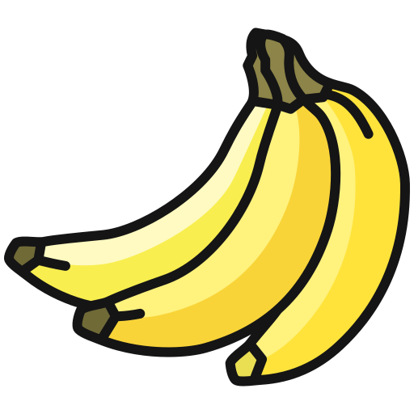
Book p.5
Practice 3
There are 8 bananas. I eat 6 bananas and Mum buys 5 bananas back. How many bananas are left?
8 – 6 + 5
= 2 + 5
= 7 (bananas)
Ans: ( 7 ) bananas are left .

Slide 9
Book p.5
1. Miss Lee has 15 rulers, a group of students borrows 6 of them but only 3 rulers are returned. How many rulers does she have now?
15 - 6＋3
Ans : She has ( ) rulers now.

Slide 10
Book p.5
2. John has 7 red balloons and 2 green balloons. Peter has 5 balloons. How many more balloons does John have than Peter?
7＋2 - 5
Ans : John has ( ) more balloons than Peter.

Slide 11
Book p.5
3. Mary has 5 pieces of cake. Her mum gives her 3 pieces more, then her sister eats 2 pieces. How many pieces of cake are left?
5＋3 - 2
Ans : ( ) pieces of cake are left.

Slide 12
Book p.5
4. Tom has 10 pencils and finds 5 more. Then he gives 3 pencils to Jerry. How many pencils does he have now?
10＋5 - 3
Ans : Tom / He has ( ) pencils now.

